Slide 1
Big Data
A day without new knowledge is a lost day.
Before we start DBT module.
Which module(s) you have completed?

Slide 2
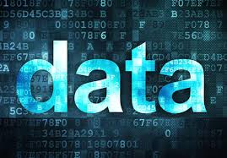
What is data?

Slide 3
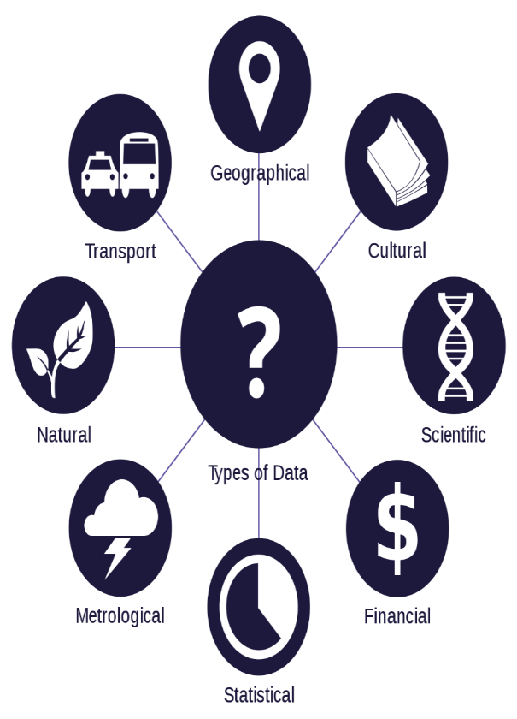
what is data
Data is any facts that can be stored and that can be processed by a computer.
Data can be in the form of Text or Multimedia
e.g.
number, characters, or symbol
images, audio, video, or signal

Slide 4
What is big data?

Slide 5
what is big data
Big Data is a collection of data that is huge in volume, yet growing exponentially with time. It is a data with so large size and complexity that none of traditional data management tools can store it or process it efficiently. Big data is also a data but with huge size.

Slide 6
Characteristics of Big Data

Slide 7
Characteristics of Big Data
It is used by many multinational companies to process the data and business of many organizations. The data flow would exceed 150 exabytes per day before replication.
There are five v's of Big Data that explains the characteristics.
5 V's of Big Data
Volume
Veracity
Variety
Value
Velocity

Slide 8
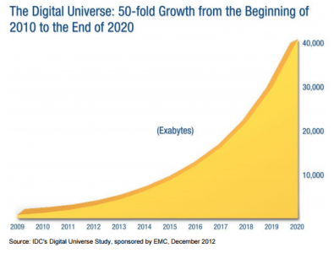
Volume
The name Big Data itself is related to an enormous size of data. Big data technologies can handle large amounts of data.
Big Data is a vast 'volumes' of data generated from many sources daily, such as business processes, machines, social media platforms, networks, human interactions, and many more.
Facebook can generate approximately a billion messages,
Billion times that the "Like" button is recorded,
and more than 350 million new posts are uploaded each day.

Slide 9
Veracity
Conformity to facts; accuracy.
Veracity means how much the data is reliable and accurate. It has many ways to filter the data. Veracity is the process of being able to handle and manage data efficiently.

Slide 10
Variety

Slide 11
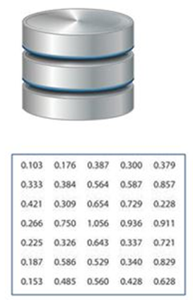
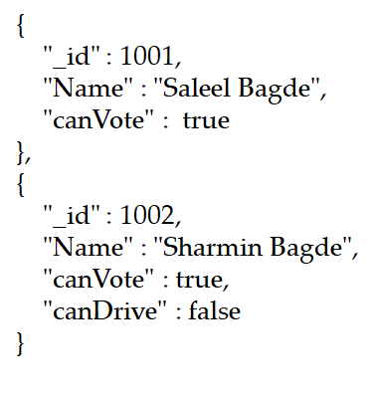

Variety
Structured
Semi-Structured
Unstructured

Slide 12
Variety
Structured
The data that can be stored and processed in a fixed format is called as Structured Data. Data stored in a relational database management system (RDBMS) is one example of ‘structured’ data. It is easy to process structured data as it has a fixed schema. Structured Query Language (SQL) is often used to manage such kind of Data.
Semi-Structured
Semi-Structured Data is a type of data which does not have a formal structure of a data model, i.e. a table definition in a relational DBMS, XML files or JSON documents are examples of semi-structured data.
Unstructured
The data which have unknown form and cannot be stored in RDBMS and cannot be analyzed unless it is transformed into a structured format is called as unstructured data. Text Files and multimedia contents like images, audios, videos are example of unstructured data.
Quasi-structured Data: The data format contains textual data with inconsistent data formats that are formatted with effort and time with some tools.

Slide 13
Value
Value is an essential characteristic of big data. It is not the data that we process or store. It is valuable and reliable data that we store, process, and also analyze.

Slide 14
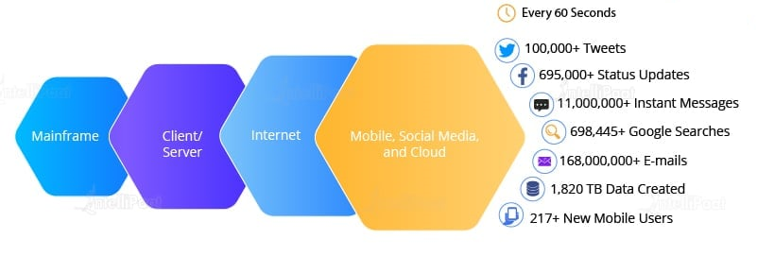
Velocity
Velocity deals with the speed at the data flows from sources like application logs, business processes, networks, and social media sites, sensors, mobile devices, etc.

Slide 15
Jobs in Big Data

Slide 16
List of Job Roles in Data Science / Big Data
MIS Reporting Executive: Business managers rely on Management Information System reports to automatically track progress, make decisions, and identify problems.
Business Analyst: Although many of their job tasks are similar to that of data analysts, business analysts are experts in the domain they work in. They try to narrow the gap between business and IT.
Data Analyst: A Data Analyst's responsibilities include the deep analysis of data and then determining the best way to represent it visually to managers and stakeholders. They also ensure quality assurance and process documentation and define Key Performance Indicators
Statistician: Statisticians collect, organize, present, analyze, and interpret data to reach valid conclusions and make correct decisions. They are key players in ensuring the success of companies involved in market research, transportation, product development, finance, forensics, sport, quality control, environment, education, and also in governmental agencies.
Data Scientist: A Data Scientist is a professional who collects large amounts of data using analytical, statistical, and programmable skills. It is their responsibility to use data to develop solutions tailored to meet the organization's unique needs.

Slide 17
List of Job Roles in Data Science / Big Data
Data Engineer/Data Architect: “Data engineers are the designers, builders and managers of the information or “big data” infrastructure.” Data engineers ensure that an organization’s big data ecosystem is running without glitches for data scientists to carry out the analysis.
Machine Learning Engineer: A Machine Learning Engineer is responsible for designing and developing machine learning systems, implementing appropriate ML algorithms, and conducting experiments. They possess strong programming skills, knowledge of data science, and expertise in statistics.
Big Data Engineer: The big data engineer's role is to Design, construct and maintain large-scale data processing systems.

